Slide 1


Development of a GPU-Accelerated Computational Platform for Bayesian Networks
Jacinta Roberts, Dr. Paul Wu and D. Prof. Kerrie Mengerson
QUT Vacation Research Experience Scheme (VRES)

Slide 2
Introduction
Why?
Computational power required for the joint in Bayesian Inference grows exponentially which can make analysis time-consuming or prohibitive. By parallelizing the algorithm, BN learning and inference could be performed in a timescale that enables real-time applications and inference in complex models.
Goals:
Review existing approaches to parallel computation for Bayesian Network inference.
Accelerate Bayesian inference using NVIDIA’s CUDA for parallel programming on the GPU.
Integrate the GPU-based solution into R to improve accessibility for existing Bayesian Network models.

Slide 3
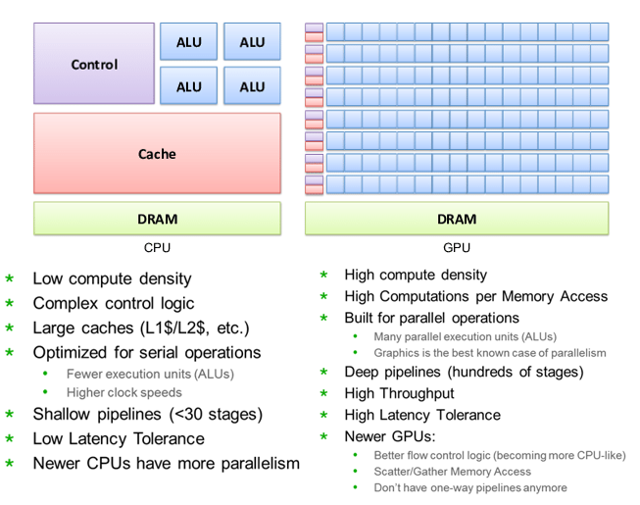
GPUs vs CPUs
GPUs have evolved into highly-programmable, general purpose computing powerhouses.
Modern GPUs greatly outperform CPUs in arithmetic throughput and memory bandwidth.
Challenge! Heterogeneous computing.

Slide 4
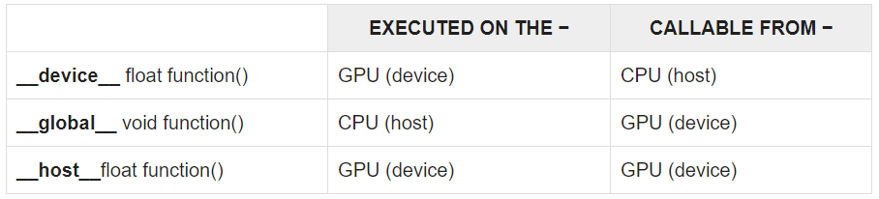

CUDA
Compute Unified Device Architecture (CUDA) is a proprietary set of language extensions that works only on NVIDIA’s GPUs. OpenCL as an alternative.
C, C++, Fortran, Python and MATLAB
Parallelism can be expressed through extensions in the form of a few basic keywords. CUDA’s kernel launch parameters, memory management and thread organization are also important to understand.

Slide 5
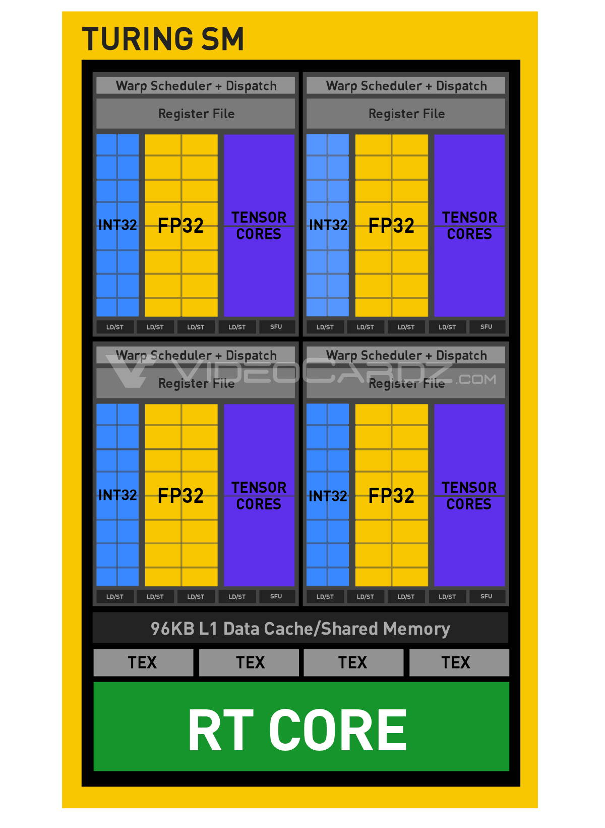
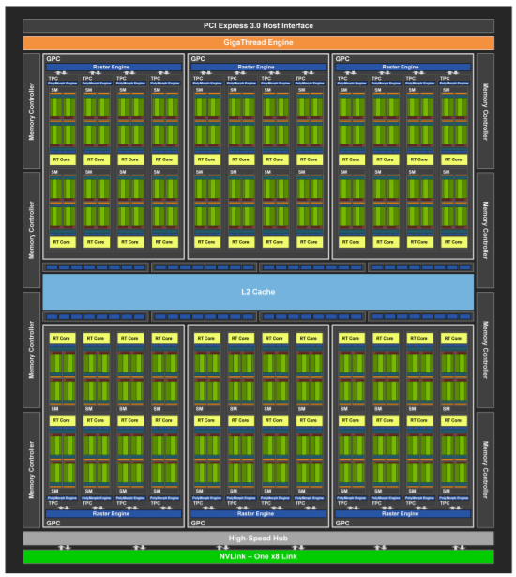
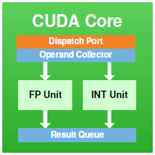
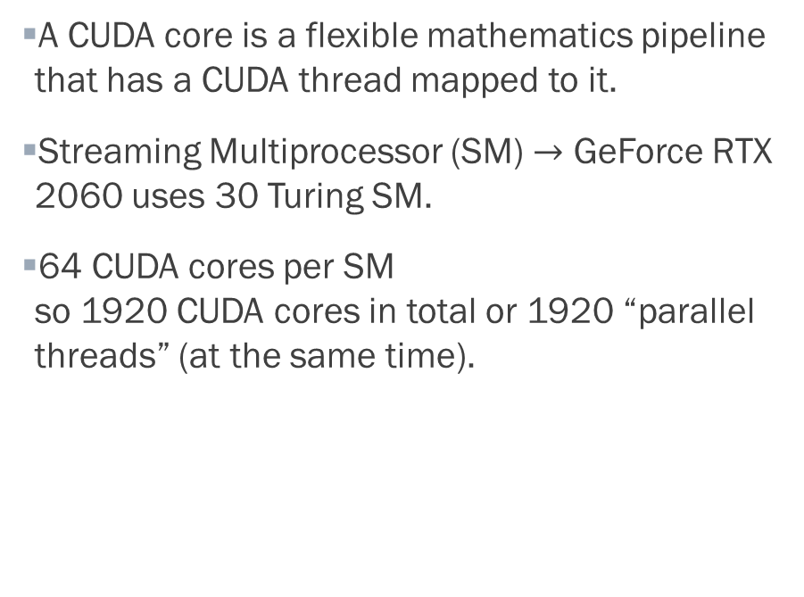
GPU Architecture
A CUDA core is a flexible mathematics pipeline that has a CUDA thread mapped to it.
Streaming Multiprocessor (SM) $→$ GeForce RTX 2060 uses 30 Turing SM.
64 CUDA cores per SM so 1920 CUDA cores in total or 1920 “parallel threads” (at the same time).
x16
x16
x16
x30
GeForce RTX 2060
x16
4

Slide 6
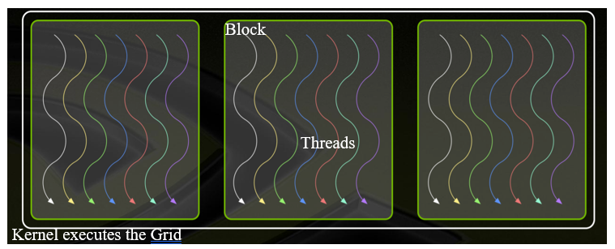
Scalable Programming with CUDA
Block Dimension and Grid Dimension are kernel launch parameters – crucial to maximize speed and balance fine-grained (↑ speedup, ↑ communication overhead) and coarse-grained parallelism (↓ communication overhead, ↑ load imbalance).
KERNEL<<<DIM OF GRID OF BLOCKS, DIM OF BLOCK OF THREADS>>>(…)
To launch a kernel named “square” with 1 block of 64 threads: square<<<1,64>>>
Best Practices:
# Threads per block should be a multiple of warp size (usually 32) (for capacity and coalescing)
# Blocks should be larger than the number of SMs (minimize latency).
5

Slide 7
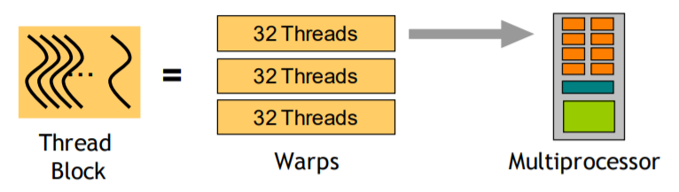
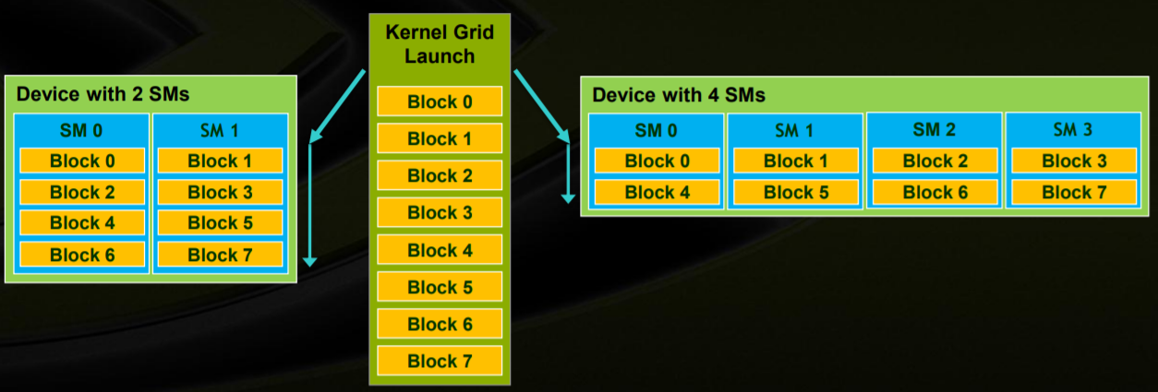
CUDA FAQs
What is a “warp”?
Group of neighbour threads that work together. Not directly accessible by the programmer (who only deals with block and grid dimensions).
The reason it is “32” is to balance efficiency (easier to keep pipelines full) and flexibility (allows smaller blocks).
Why not just use 1 massive block that hosts all the threads?
Each block is mapped to an individual SM. Consider an older GPU with a smaller number of SMs, having blocks allows it to still operate serially, whereas a powerful GPU can run many blocks in parallel.
Why use Shared Memory as opposed to Global Memory?
Memory that is only accessible by the threads within the same block. Faster than global memory and allows threads to reuse data already pulled out (similar to “caching”).
6

Slide 8
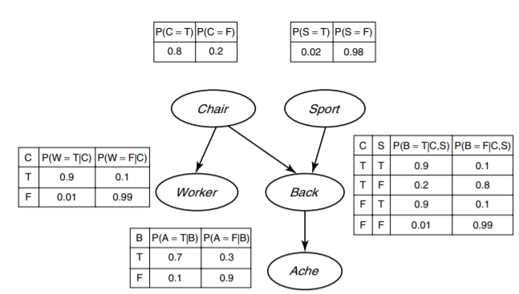

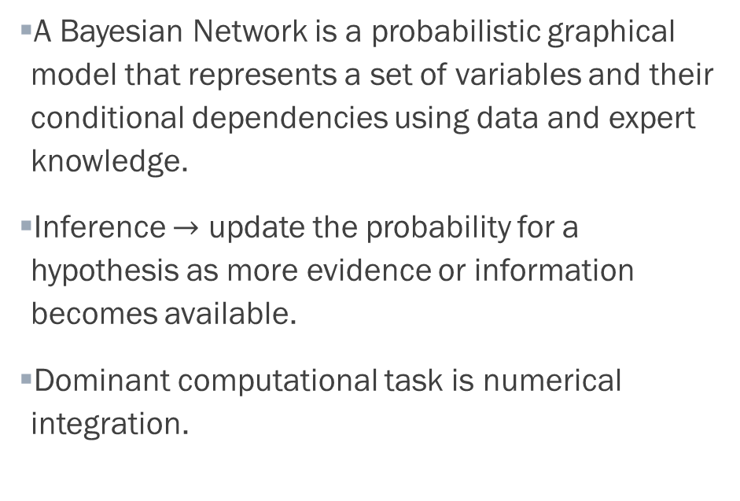
Bayesian Inference
A Bayesian Network is a probabilistic graphical model that represents a set of variables and their conditional dependencies using data and expert knowledge.
Inference $→$ update the probability for a hypothesis as more evidence or information becomes available.
Dominant computational task is numerical integration.

Slide 9
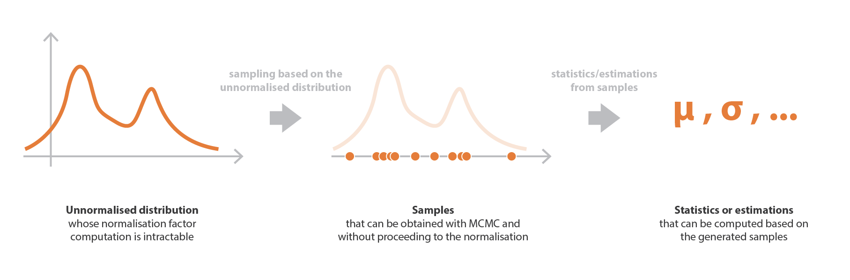
Fundamentals of MCMC
Markov chain Monte Carlo (MCMC) algorithms generate samples from a distribution and use these samples to compute various statistics such as mean and variance or even to approximate the distribution by Kernel Density Estimation.

Slide 10
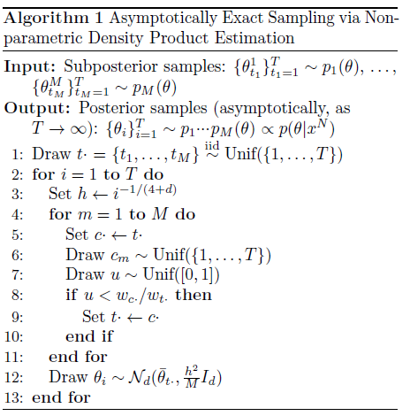
Embarrassingly Parallel MCMC
Algorithm by Neiswanger et al. (2014) suggests to run MCMC on each machine/block on a subset of the data (without communication) and then samples from each machine are combined to construct samples from the full-data posterior distribution.
At each step in the Markov chain, a single dimension of the current state is sampled independently of its current value (keeping other dimensions fixed) and then it is accepted or rejected based on its mixture weight.
Input: Subposterior samples.
Output: Posterior samples.

Slide 11
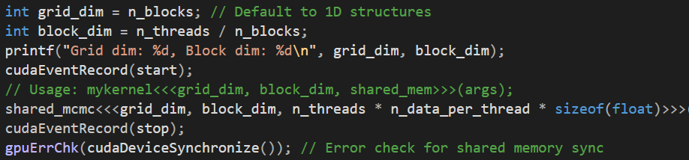

Code Overview
1. Generate sample data (# dimensions and # samples) – currently use simple Python script to generate random samples from a multivariate normal distribution of specific dimension to .txt file.
Due to time restrictions, I focused on achieving speedup with simplified input.
Next focus point is on restricting samples in the DAG space constrained by a given BN skeleton.
2. Parameter passing (kernel configuration $→$ # threads, # blocks and read in the dataset) for experimental analysis.
3. Event timing
4. Run MCMC in parallel
5. Combine results

Slide 12
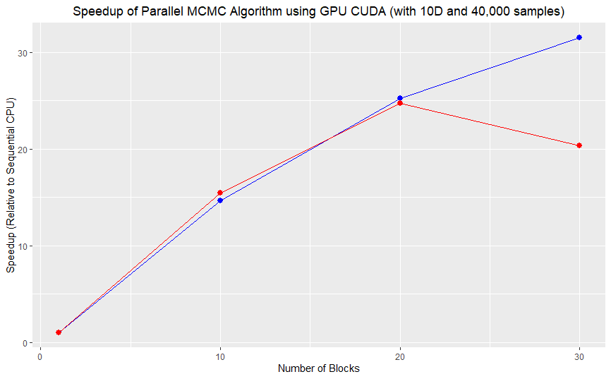
Results
Up to 31.5 orders of magnitude in speedup for the parallelized MCMC algorithm, varying depending upon sample size, number of dimensions and GPU hardware.
Using a NVIDIA GeForce RTX 2060 with 40,000 samples with 10 dimensions. The CPU sequential time was 25.6s and a time of 0.814s was achieved with 30 blocks and 128 threads/block (31.5x speedup). Blue line is 128 threads/block and Red line 256 threads/block.

Slide 13
Limitations and Future Work
Future work required to integrate the GPU-based solution into R for it to be used with BNs in a more accessible way. Interpretation of discrete values/CPTs for simple cases and change the input so that it can handle samples in the DAG space constrained by a given BN skeleton.
Limitation - The algorithm selected holds only for posterior distributions over finite-dimensional graphical models with unconstrained variables.
Potentially better speedup with other hardware/distributed systems, alternative algorithms could be explored.

